Slide 1
Boosting Algorithm
Hope AI
Thanigaivel G

Slide 2
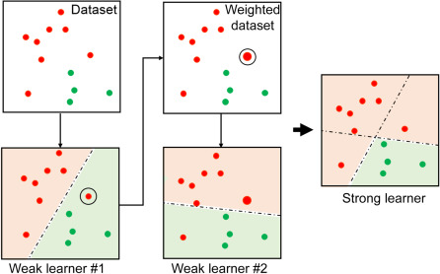
Boosting Algorithm
Boosting Algorithm Builds a Model by combining the outputs of several weak models

Slide 3
Pros and Cons of Boosting Algorithm
Advantages :
Improved Accuracy
Robustness to Overfitting
Better Handling of Imbalanced Data
Better Interpretability
Disadvantages :
Boosting Algorithms are vulnerable to the outliers
It is difficult to use boosting algorithms for Real-Time applications.
It is computationally expensive for large datasets

Slide 4
Types of Boosting Algorithm
There are several types of boosting algorithm available, they are
Gradient Boosting
XGBoost
AdaBoost
CatBoost

Slide 5
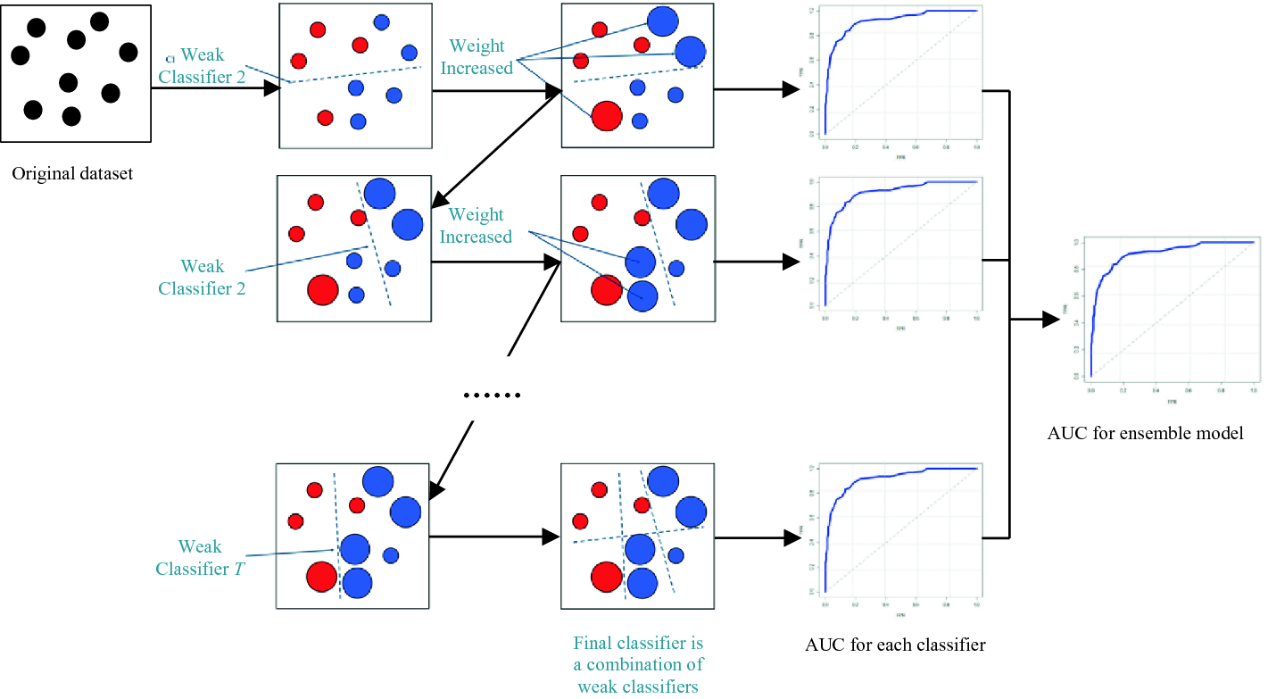
Gradient Boosting
Gradient Boosting is a machine learning technique used for regression and classification tasks and it is an ensemble learning method that sequentially adds models to correct errors made by previous models

Slide 6
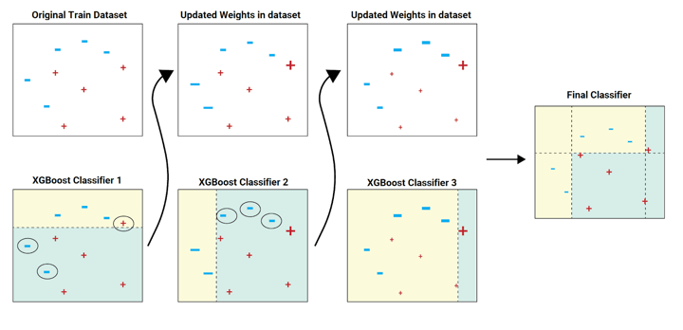
XGBoost Algorithm
XGBoost (Extreme Gradient Boosting) is an advanced implementation of the gradient boosting technique which combines multiple weak learners to improve prediction accuracy by correcting the errors of previous models, utilizing gradient descent optimization to minimize a loss function

Slide 7
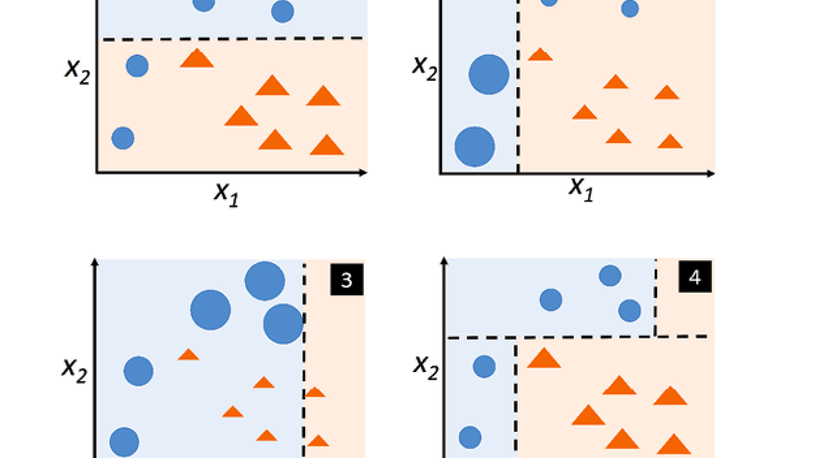
Adaboosting Algorithm
Adaboosting is an ensemble learning method that works by iteratively training weak models, adjusting the weights of incorrectly classified instances to focus on harder cases in subsequent iterations. The final model is a weighted sum of all the weak models, with more weight given to those that performed well.

Slide 8
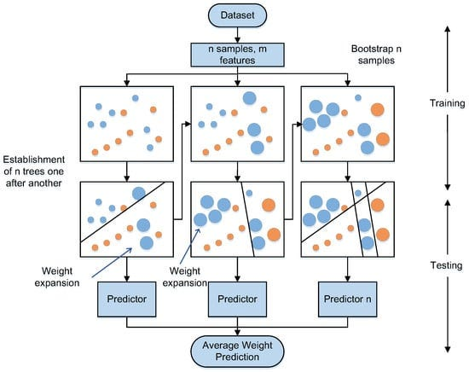
Catboosting Algorithm
CatBoost is a gradient boosting algorithm for handling categorical features effectively, it uses ordered boosting to reduce overfitting and provides robust handling of categorical features, making it a powerful tool for various machine learning tasks.

